Slide 1
Marketing Mix Modelling on Advertising Data
Full analysis in Advertising_MMM.xlsx

Slide 2
Sales performance over Time

Slide 3
Advertising Channels
TV
Radio
Newspaper

Slide 4
Sales & Advertising Expenses over Time

Slide 5
Correlation of TV Expenses with Sales
Correlation coefficient = 0.7822

Slide 6
Correlation of Radio Expenses with Sales
Correlation coefficient = 0.5762

Slide 7
Correlation of Newspaper Expenses with Sales
Correlation coefficient = 0.2283

Slide 8
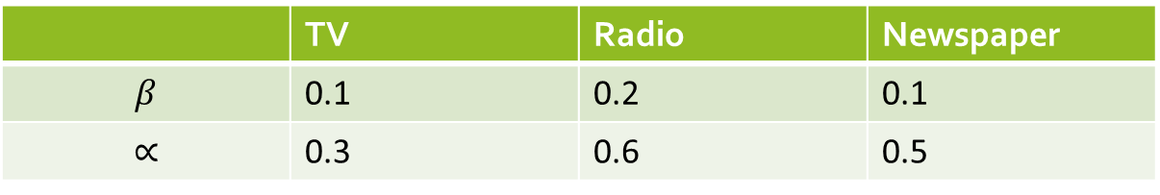

Data Transformation
Adstock
$$Adstock\left(t\right)=Adstock\left(t−1\right)×β+Expense(t)$$
Diminishing Return
$$Return={Adstock(t)}^{α}$$
 | TV | Radio | Newspaper
$$β$$ | 0.1 | 0.2 | 0.1
$$∝$$ | 0.3 | 0.6 | 0.5

Slide 9
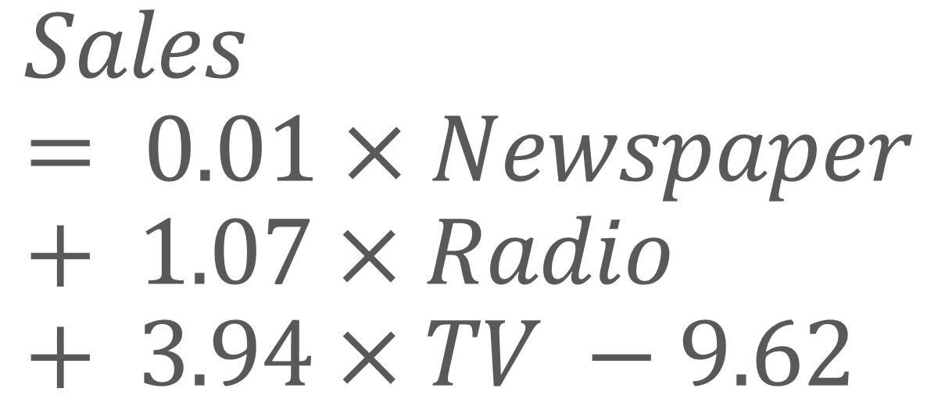
$$Sales = 0.01×Newspaper+ 1.07×Radio+ 3.94×TV −9.62$$
Regression Model
R Square | 0.9182
RMSE | 1.5040

Slide 11
THE END

